Slide 1
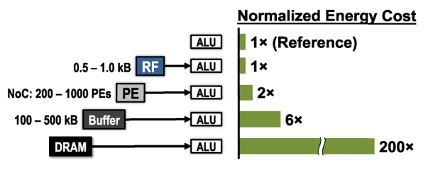
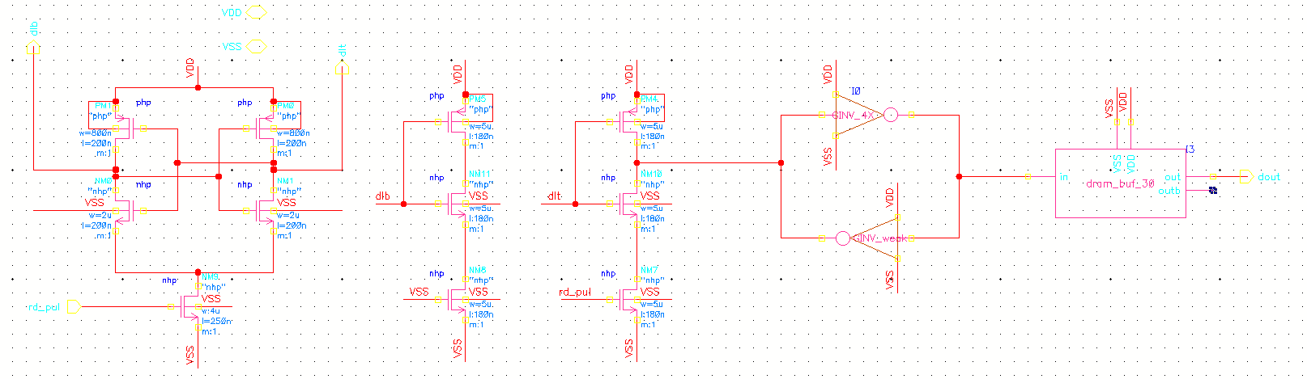
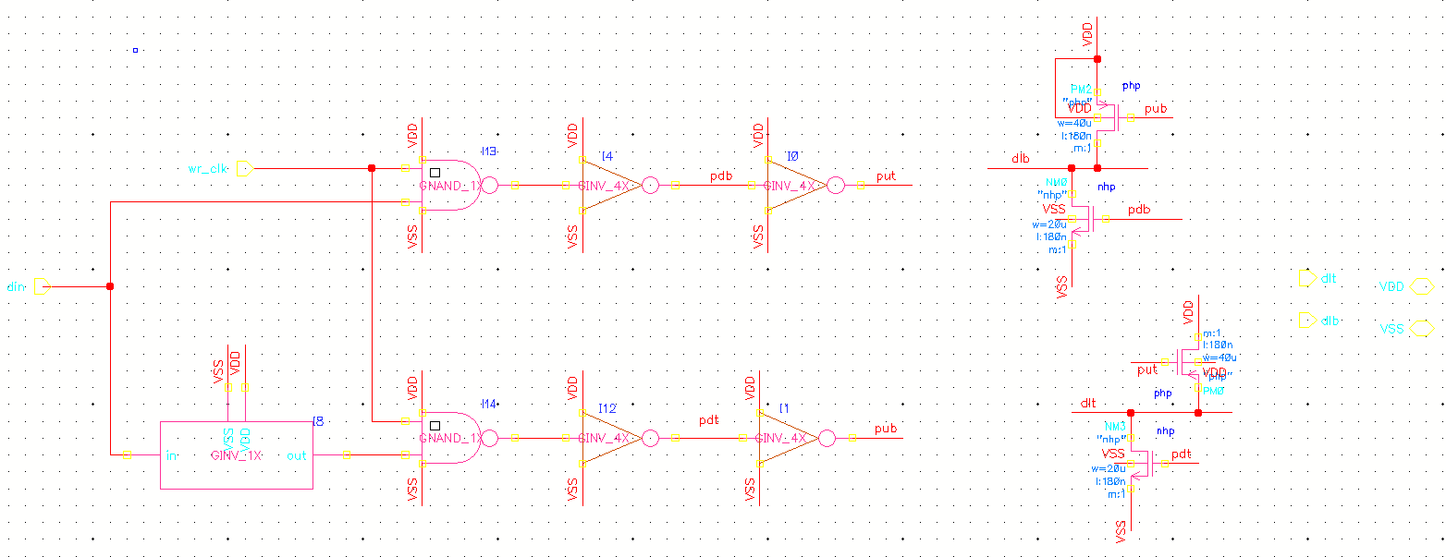
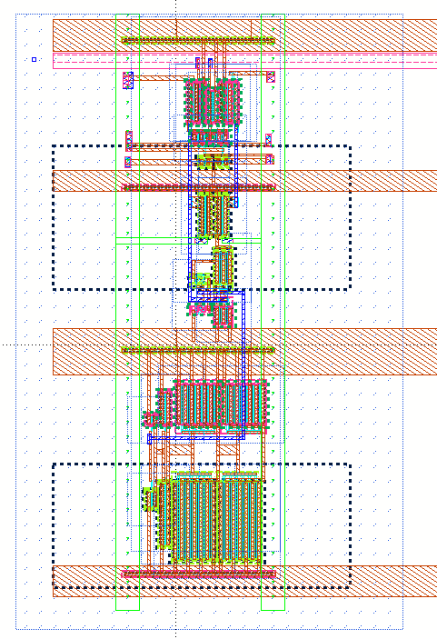
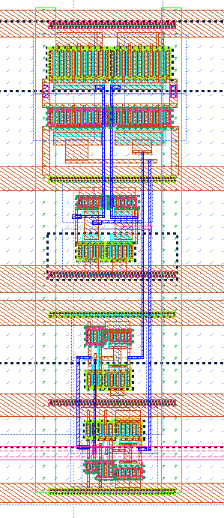
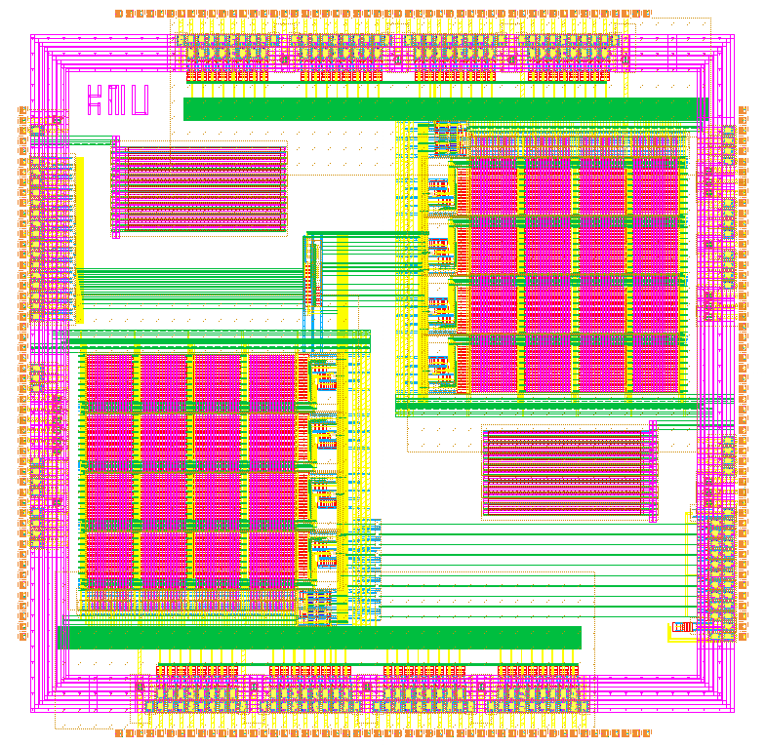
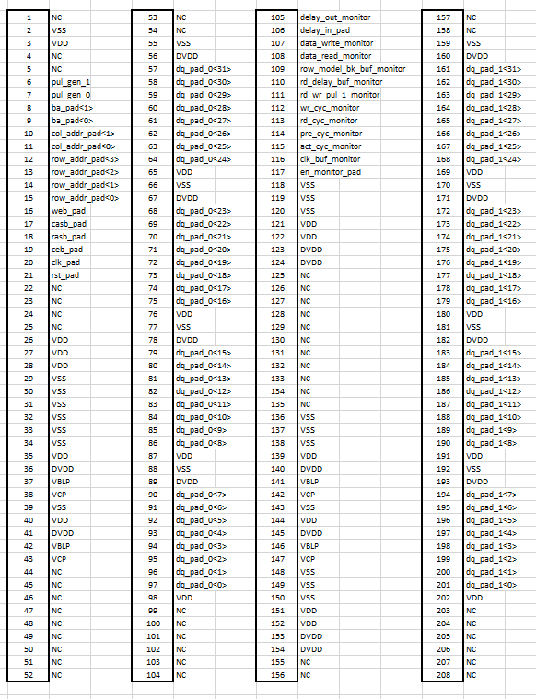
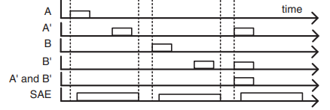
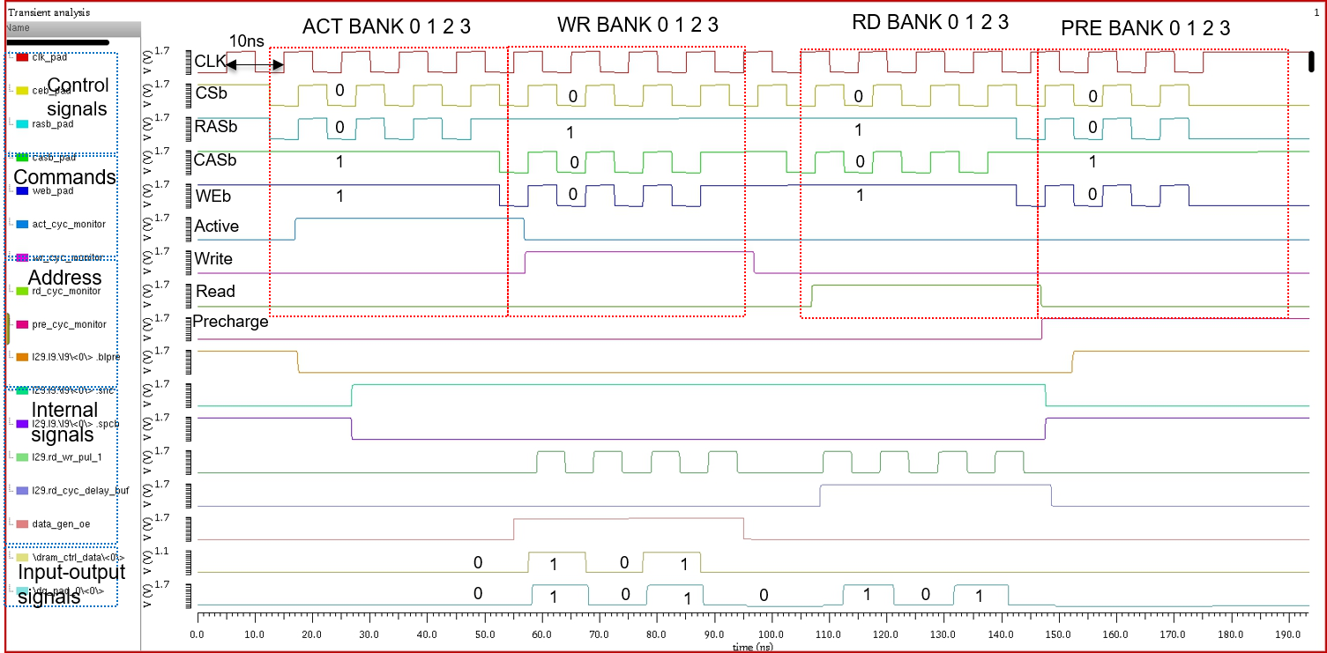
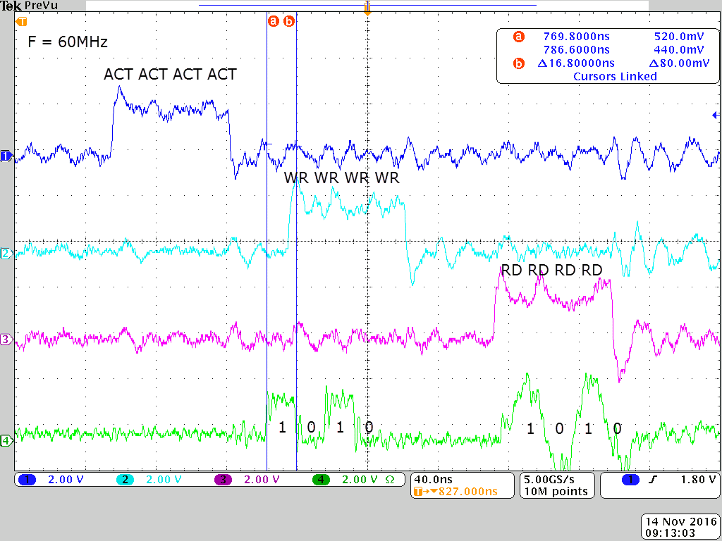
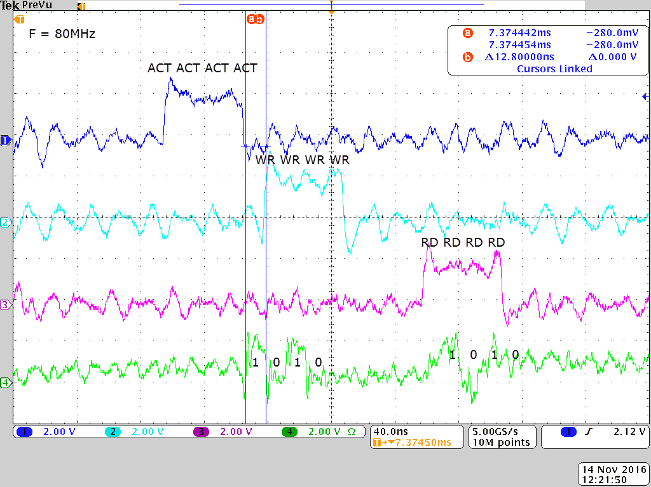
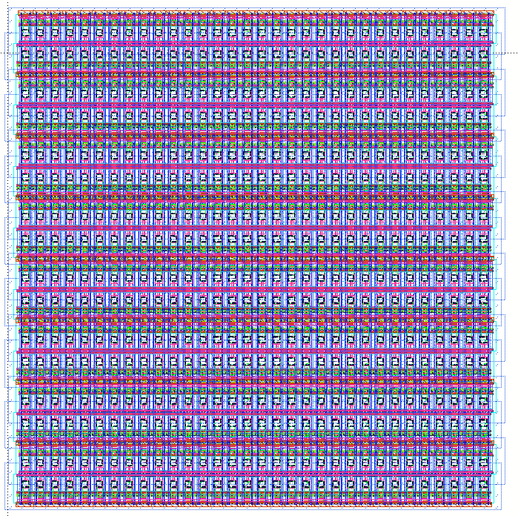
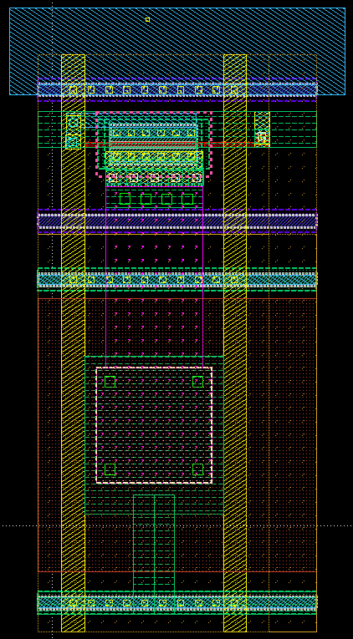
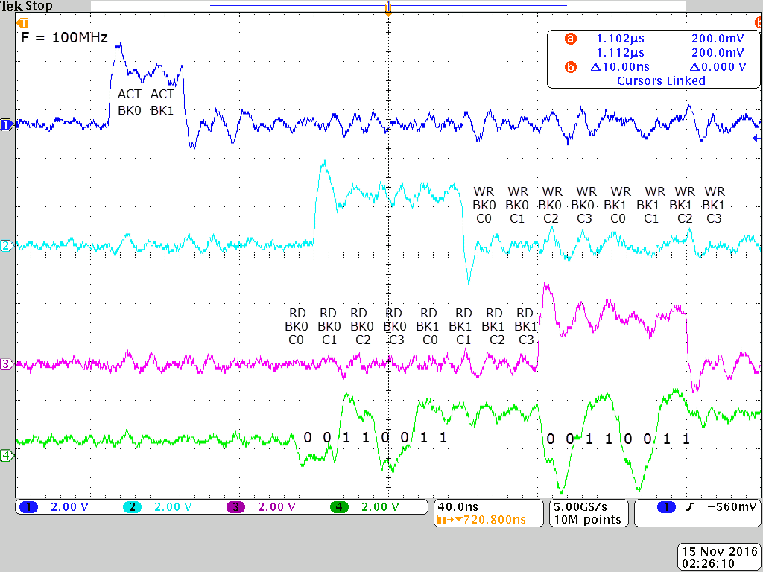
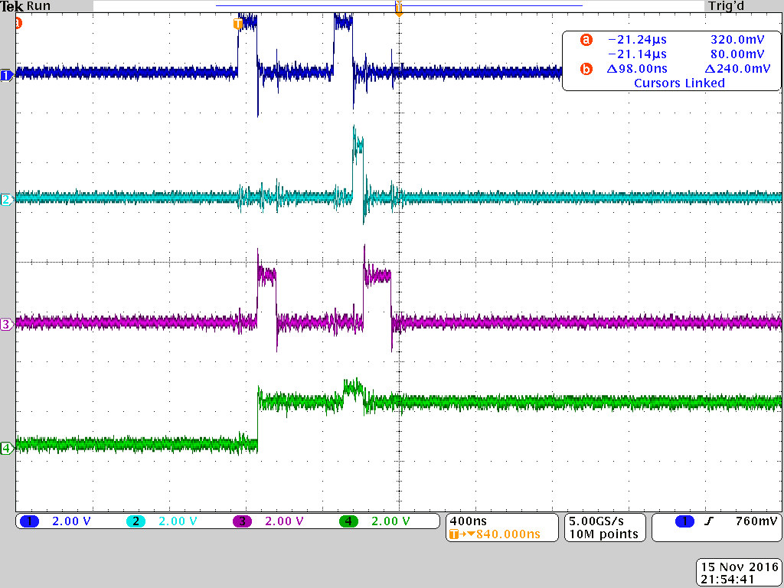
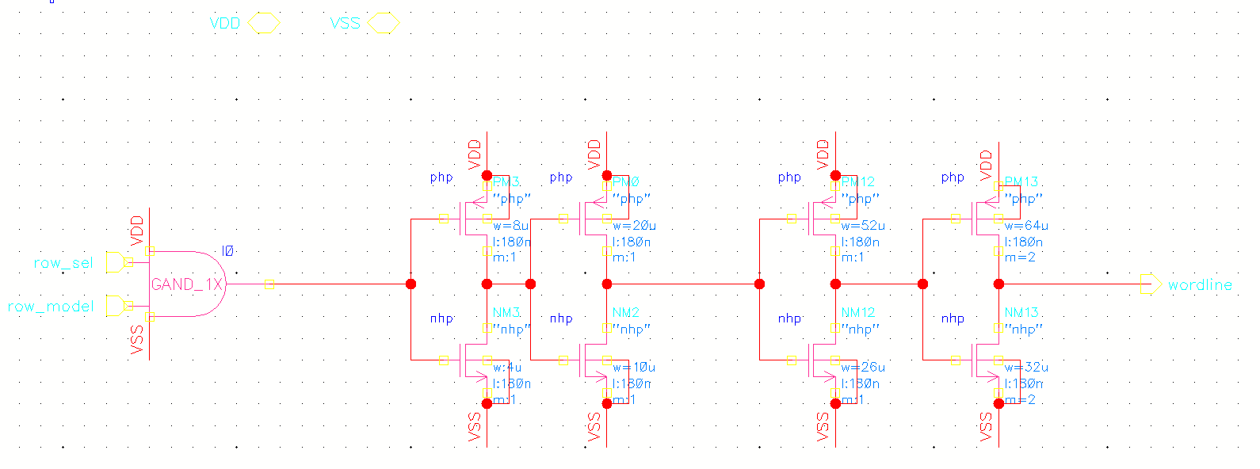
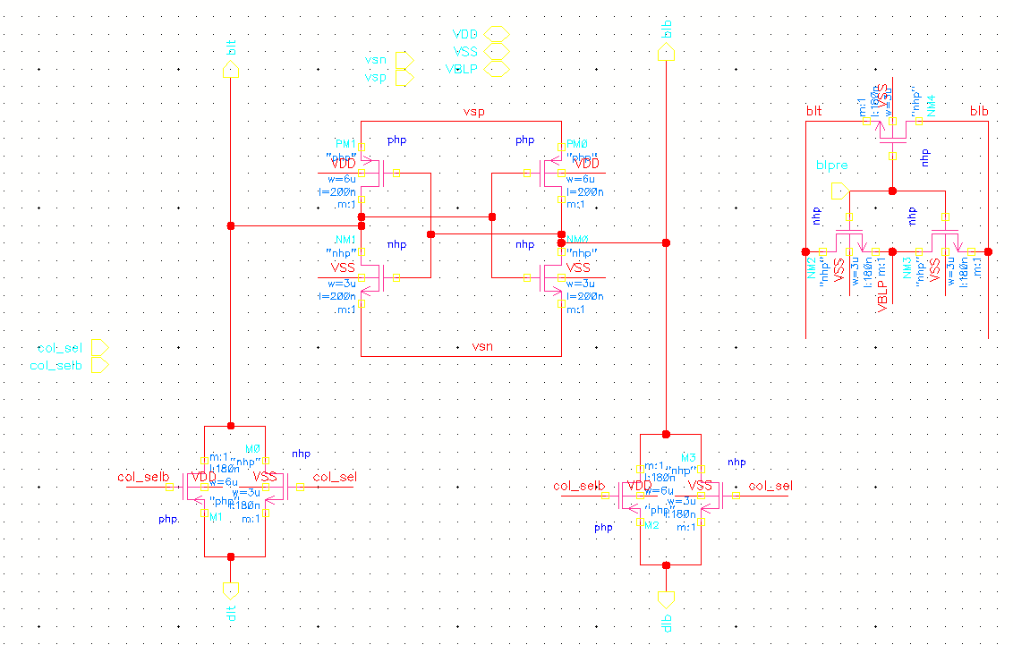
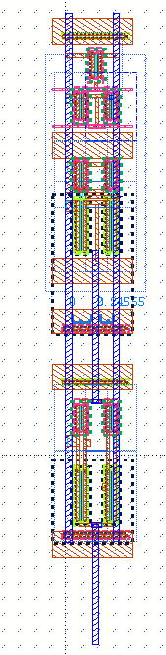
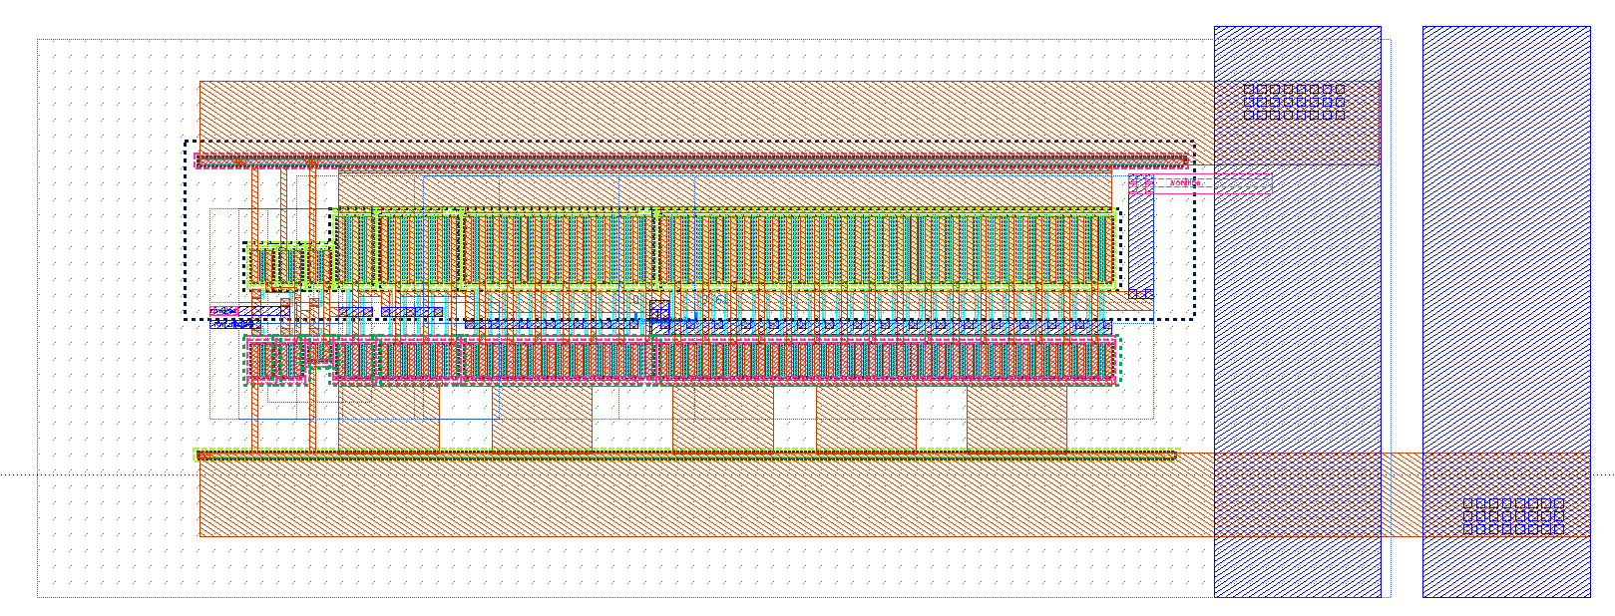
Computer-In DRAM Circuits for Quantized Neural Networks
Nguyen Van Tien, Jiyong An, and Kyeong-sik Min
School of Electrical Engineering, Kookmin University, Seoul, Korea
Introduction
Read amp / Write amp
Energy and timing inefficient
Computation-in-DRAM for
binary neural networks
Synaptic weight : -1,0,1
Input pixel : 256
Neuron : 1,2,3(bit)
Read amp
Write driver
Command table / layout / pin map
Command | ACTIVE | READ | WRITE | PRECHARGE | NOP
CEB | L | L | L | L | L
RASB | L | H | H | L | H
CASB | H | L | L | H | H
WEB | H | H | L | L | H
Simulation results
Circuits | Intra-bank bitwise | Inter-bank bitwise
# of row activation cycles to complete the convolution for 16×16 feature map (cycles) | 192 | 65
Power consumption per one receptive field (µW) | 1061 | 722
Intra-bank AND operation
: Spend many cycles and energy
Measurement
Chip Architecture
Simulation
Bank
Peri_cont
DRAM_monitor
64
wordline
drivers
16 wordlines/128 bitlines
Simulation (SS corner, 125C, V=1.6V, F=100MHz) | Simulation (TT corner, 27C, V=1.8V, F=100MHz)
DRAM operation test (CLK=60MHz) | DRAM operation test (CLK=80MHz)
DRAM operation test (CLK=100MHz) | DRAM operation test (Retention time)
128 sense amps
Bank0
Bank1
16 wordlines/128 bitlines
128 sense amps
16 wordlines/128 bitlines
128 sense amps
16 wordlines/128 bitlines
128 sense amps
DRAM_IO
32 columns
32 read amps
32 write drivers
DRAM Cell
2 banks, 64 IOs
WL
0.5/0.18
BLT
C=35f
W/L=4/4
VCP
ACT
ACT
RD
WR
RD
Wordline driver / Sense amp
Measured at TT corner condition and 60,80,100Mhz, we got retention time : 1 second
Conclusion
- Computation in DRAM can be useful for neural network applications
- Convolution can be performed by in-DRAM operation
- Wide I/O dram macro designed and tested for possible use of binary
neural networks
Wordline driver
Sense amp
2020 IDEC Congress CDC

